Slide 1
Word Clouds
Start a discussion with word art!
Ronnie O’neill
April 8, 2017

Slide 2
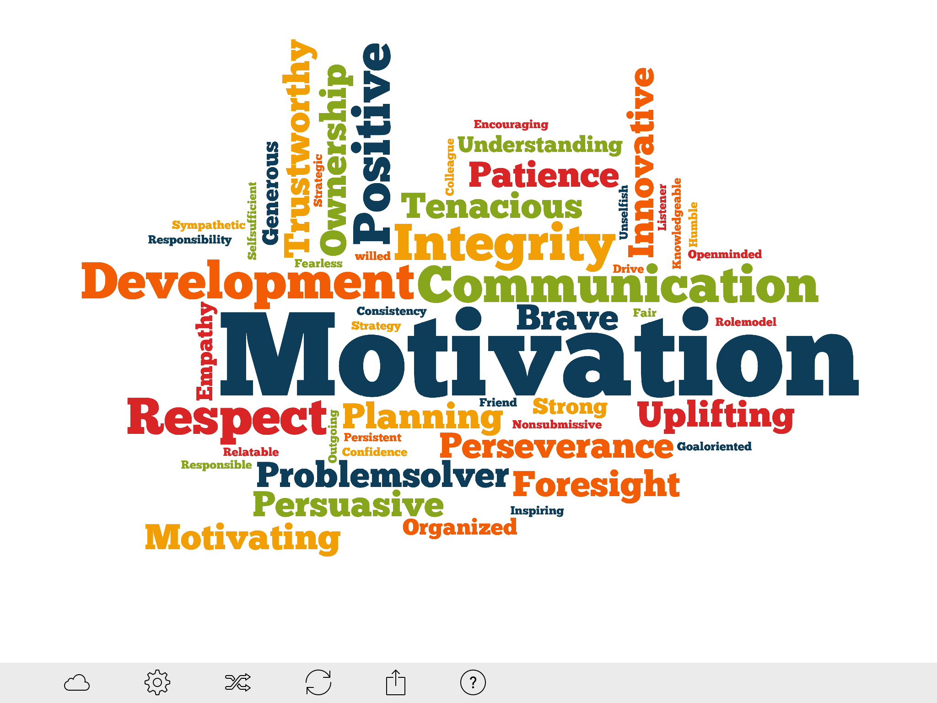

Slide 3
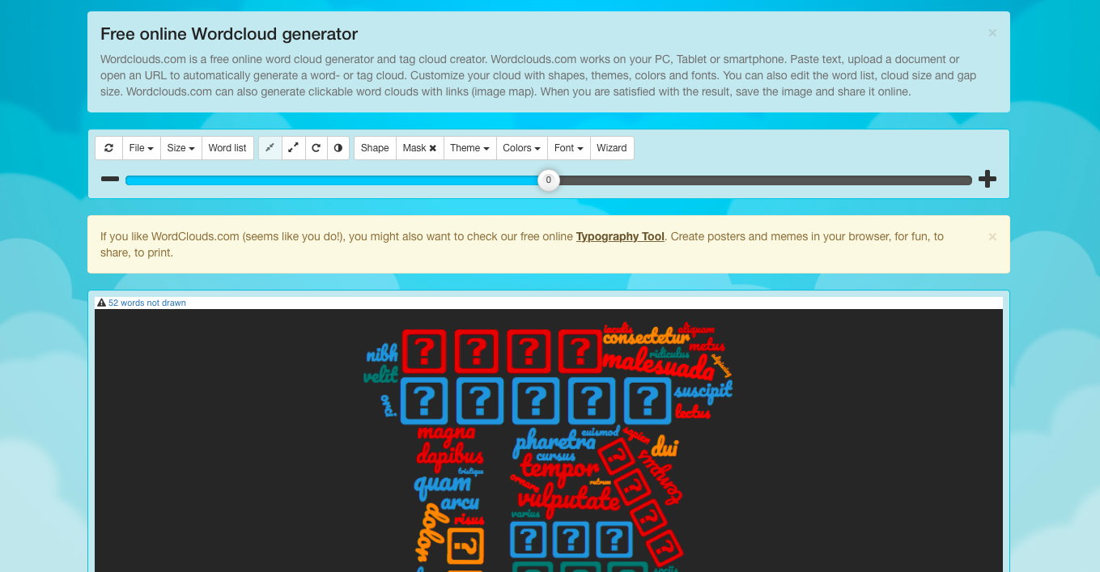

Slide 4
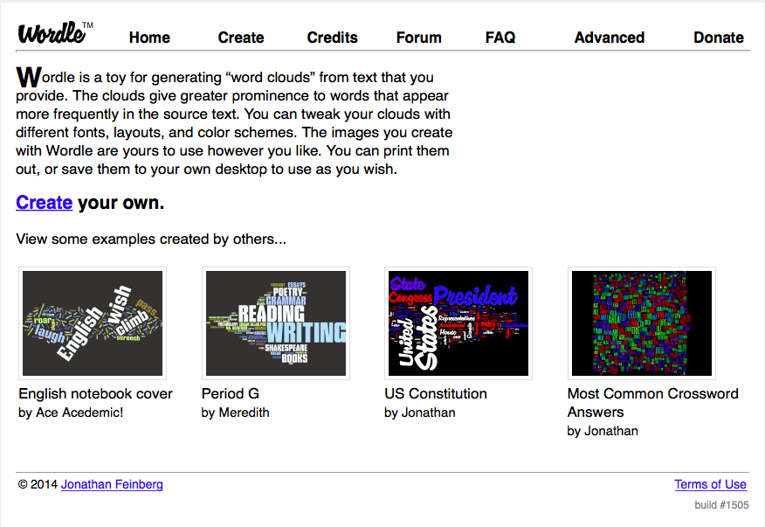

Slide 6
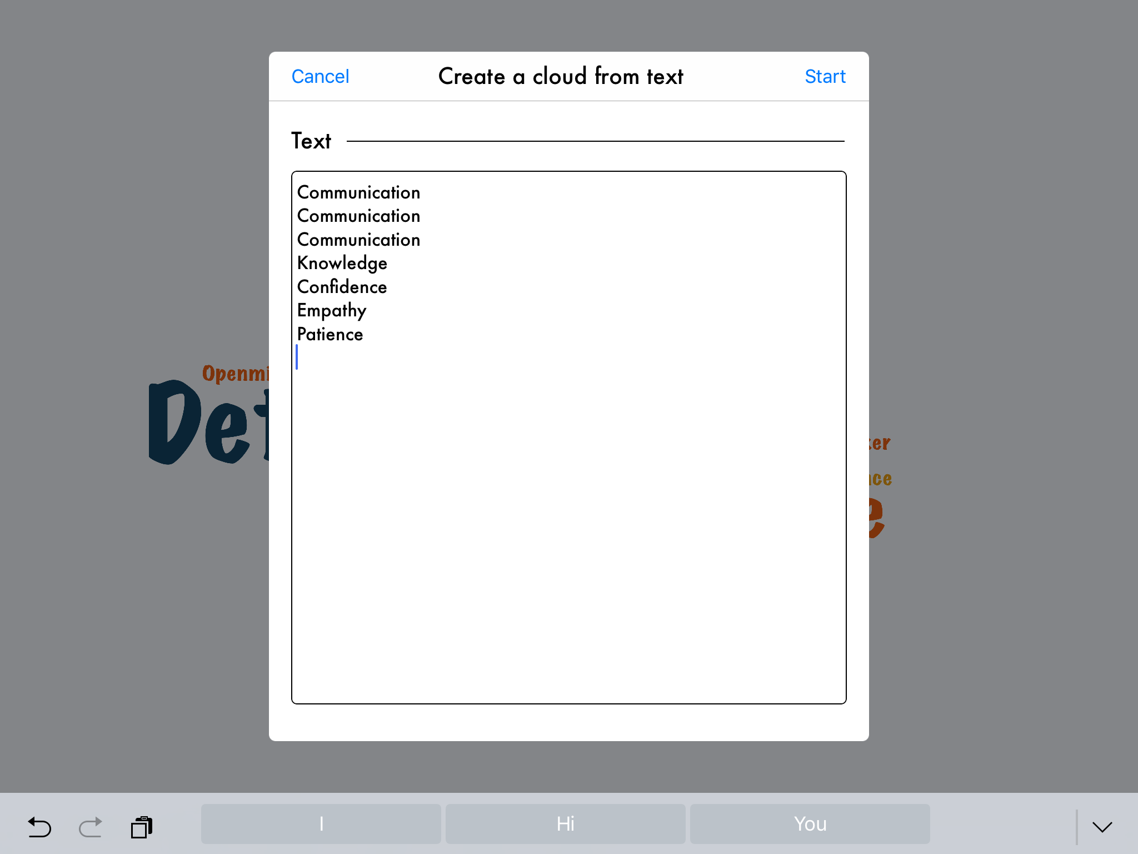

Slide 10
